Slide 1
AcCessing HSBP Interest surveys Career Clusters

Slide 2
Why is the High School and Beyond Plan Important?
There are several components to your High School and Beyond plan that must be completed for Graduation
Career Interest Inventory – Including Career Clusters
Career Goals
Educational Goals
Four-year Course Plan/Postsecondary Plan
Graduation Pathway
Financial Aid (FAFSA) Information
Resume

Slide 3
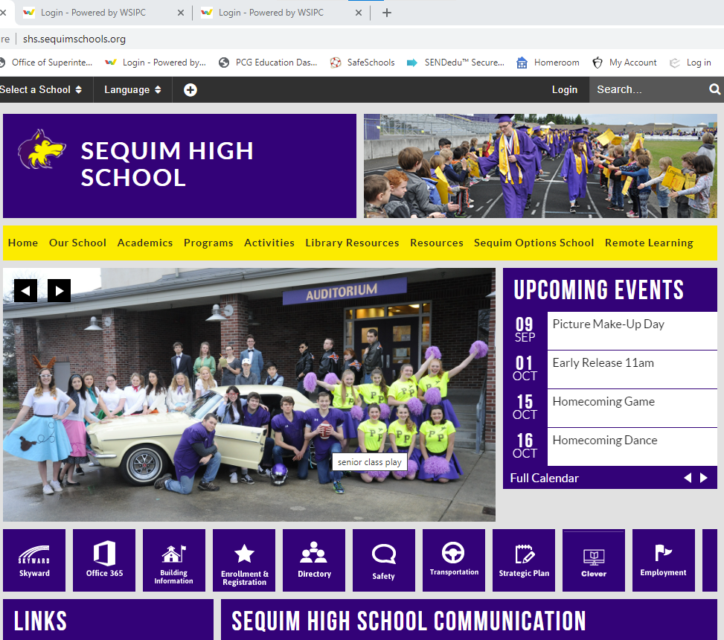
How do I access the High School and Beyond Plan?
Log into Clever through the Sequim High School webpage here:

Slide 4
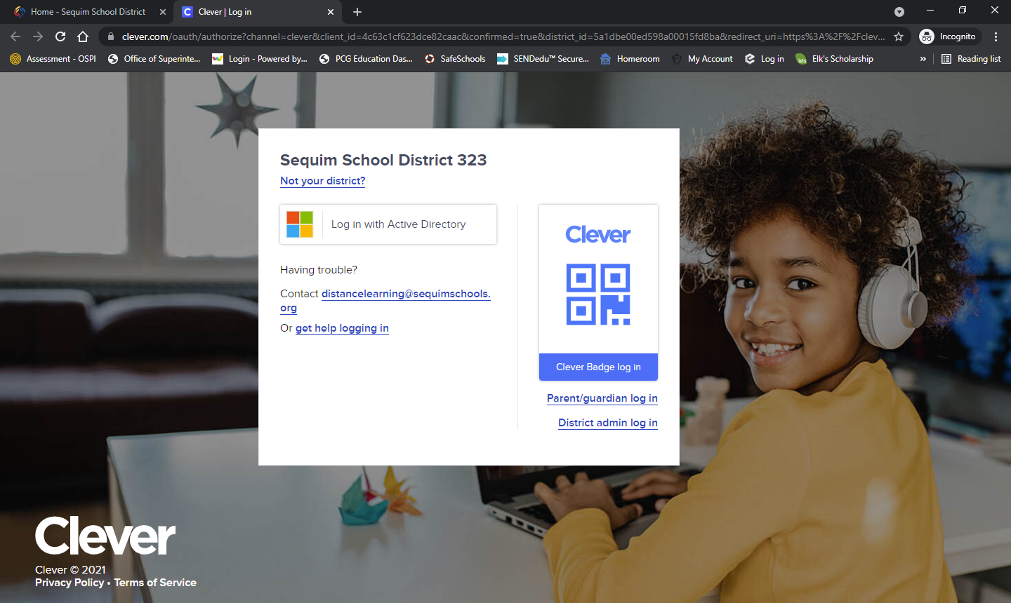
How do I access the High School and Beyond Plan?
Click here:

Slide 5
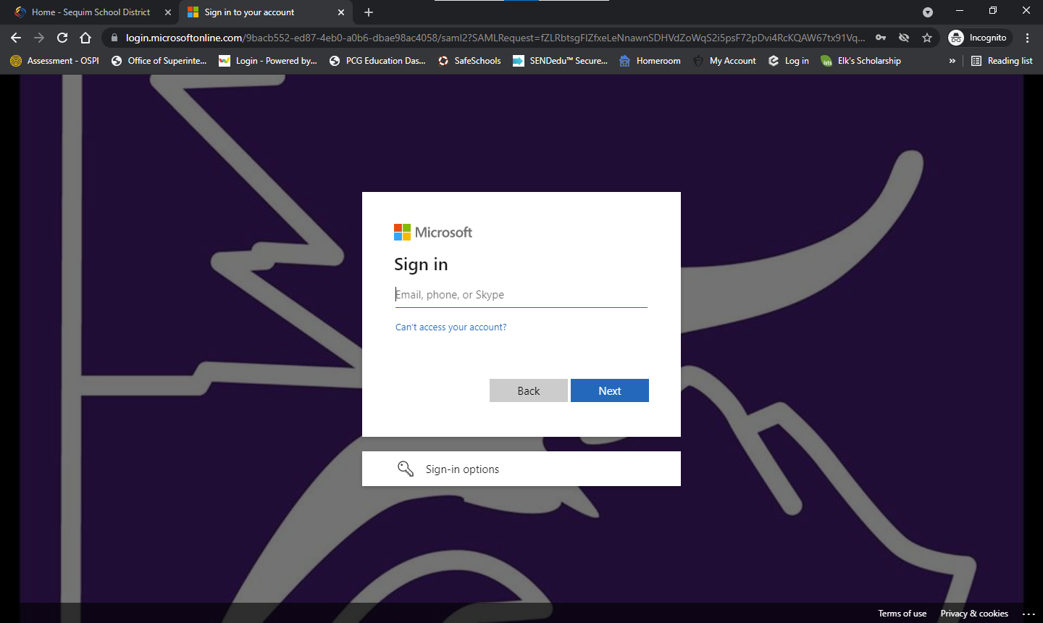
How do I access the High School and Beyond Plan?
Enter your school email here:
Your school email is your student ID#@sequimschools.org

Slide 6
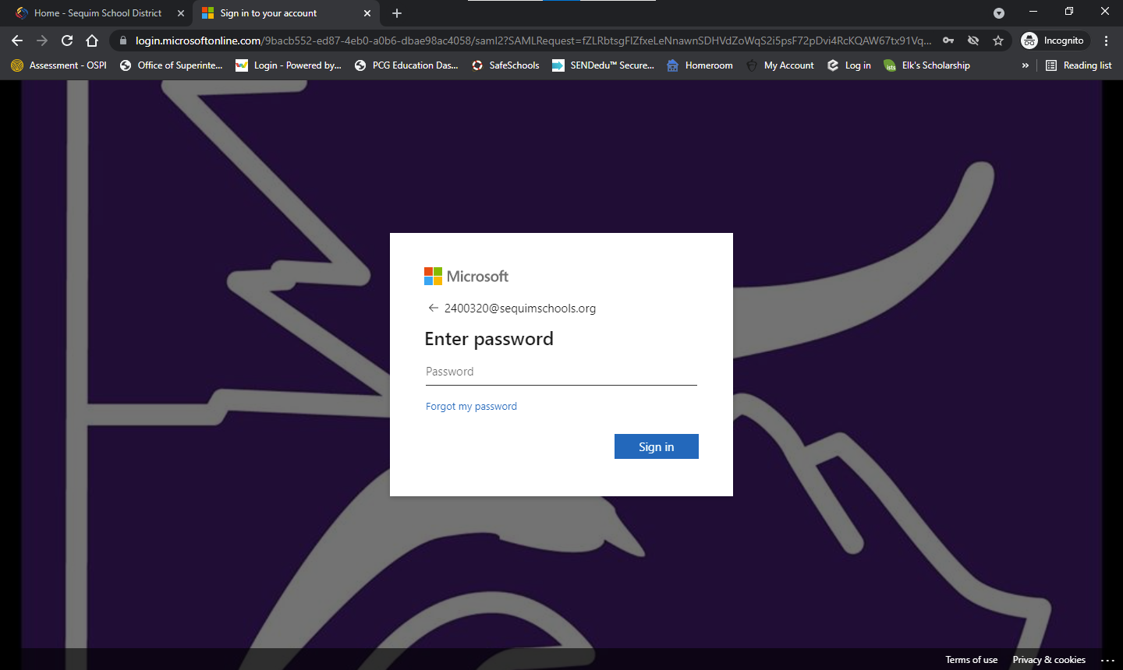
How do I access the High School and Beyond Plan?
Enter your password here:
If you have not logged in yet, your password might be your student ID# with an ! at the end
123456!

Slide 7
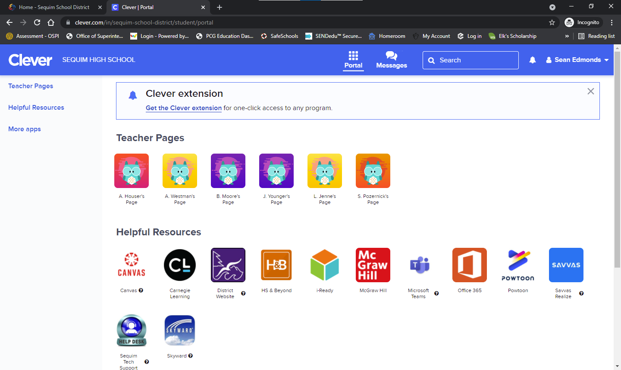
Once you have accessed Clever:
Select the orange High School and Beyond Plan icon here:

Slide 8
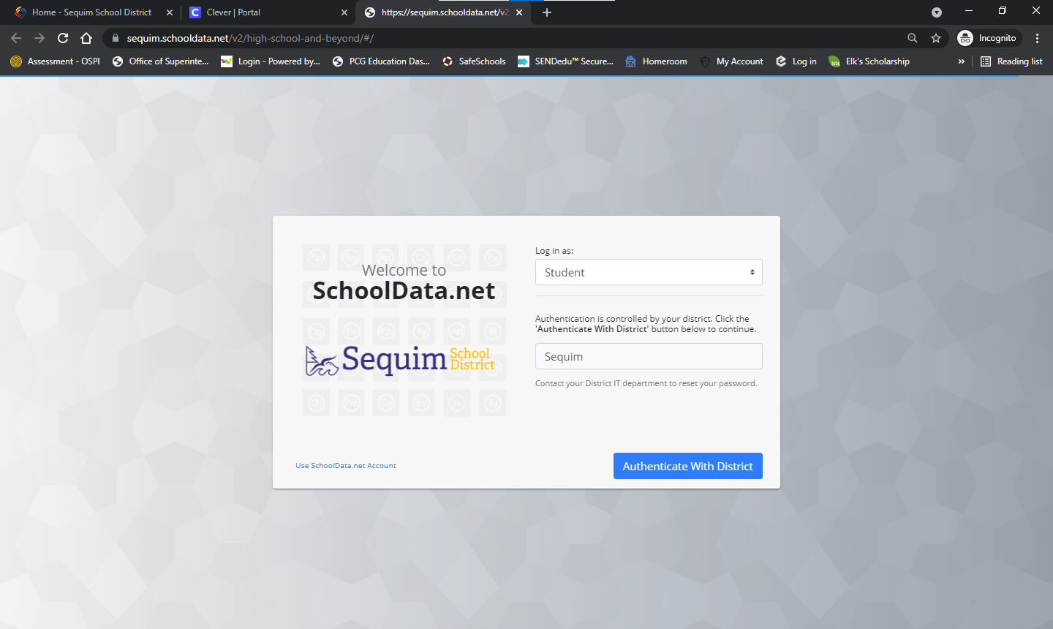
High School and Beyond Plan:
Login as a student and click here:

Slide 9
High School and Beyond Plan:
Click here to access your High School and Beyond Plan

Slide 10
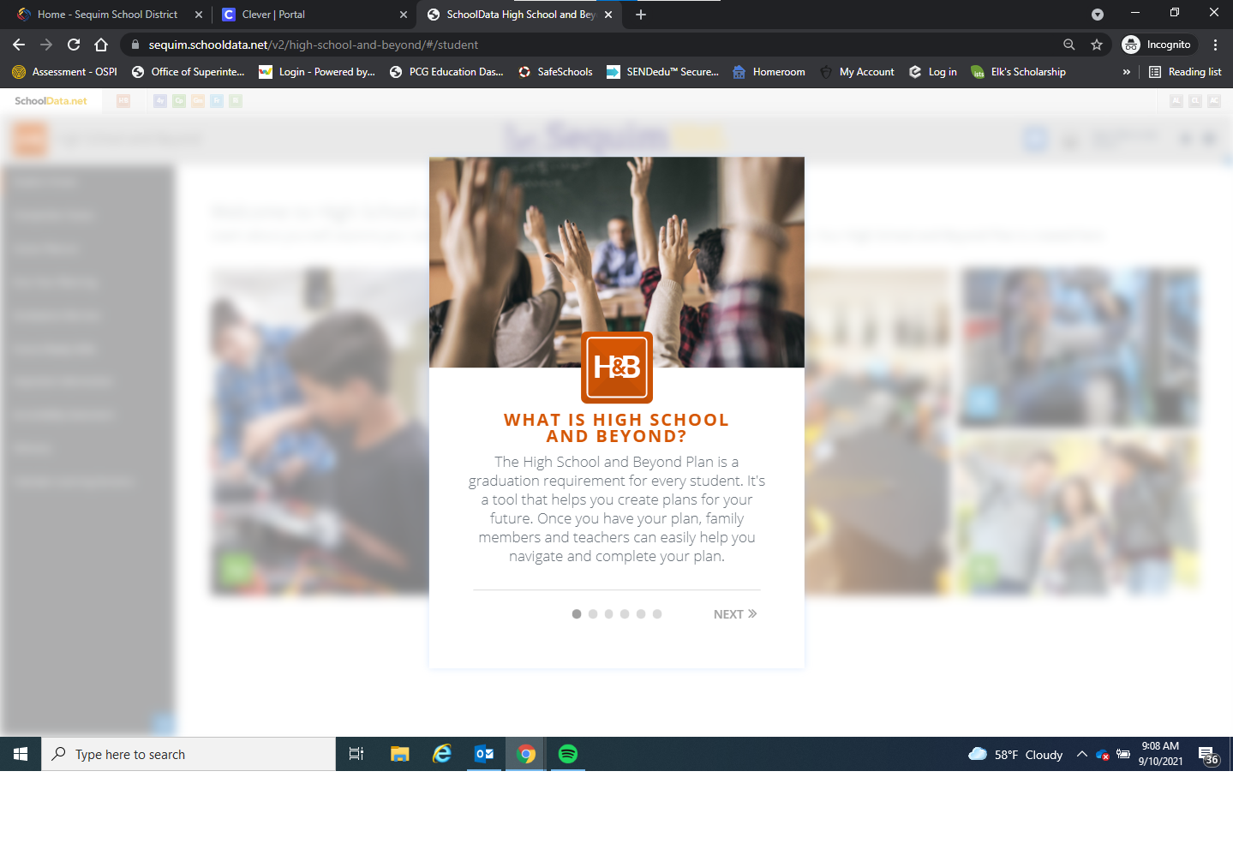
High School and Beyond Plan:
You can read a little more about the High School and Beyond plan here:

Slide 11
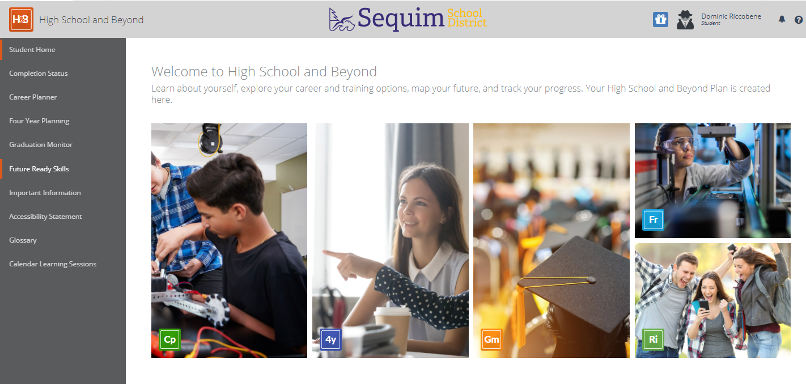
There are lots of areas to explore.
A quick way to access all of the required components for graduation is by clicking here:
Completion Status

Slide 12
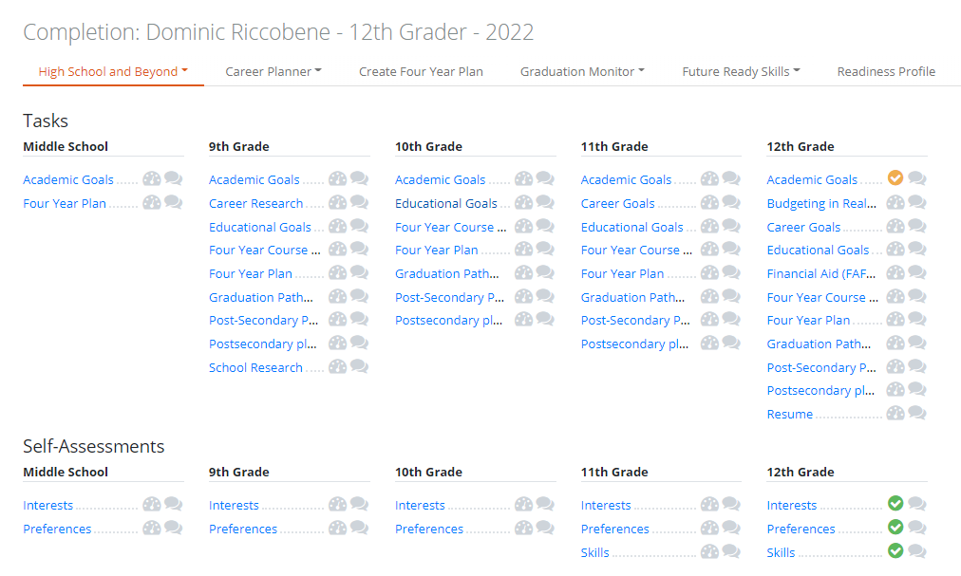
There are lots of areas to explore.
We are going to work on the three interest inventories first.

Slide 13
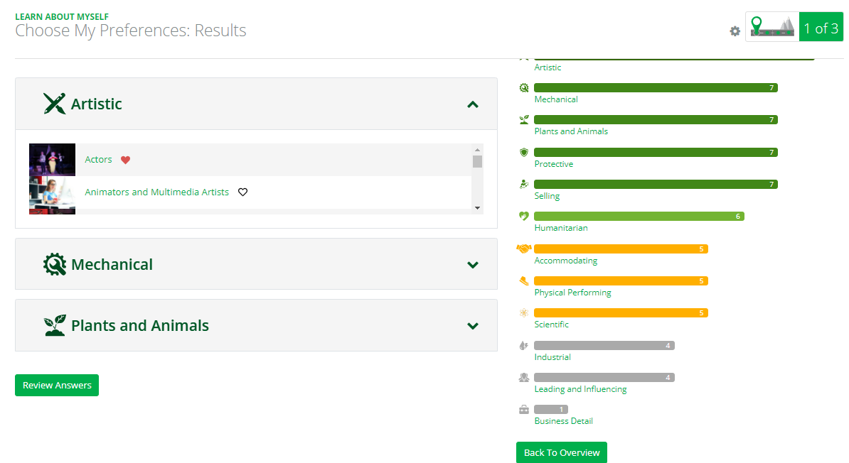
The Career Planner has a lot of options.
To fulfill Graduation Requirements, we must complete all three interest inventories and select our favorite careers to create career clusters.
If you have already taken a survey, it might look like this:
Click on "Back to Overview"

Slide 14
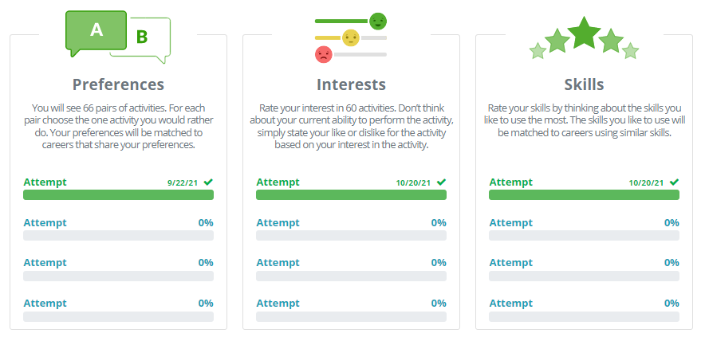
The Career Planner has a lot of options.
Once you are on this screen, you can select the survey(s) you have not yet completed.
You only need to take each survey once.
When your survey results show potential careers, make sure you "Favorite" several of the careers that interest you.

Slide 15
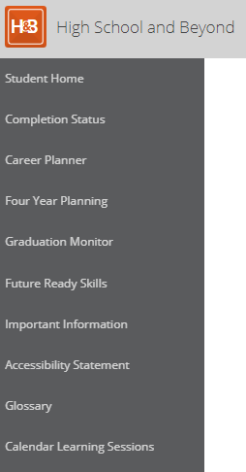
IF you are not able to access the surveys this way, here's another option:
#1
#3
Click on the HB in the upper left corner of your screen
Select Career Planner from the menu on the left side
Click Overview
#2

Slide 16
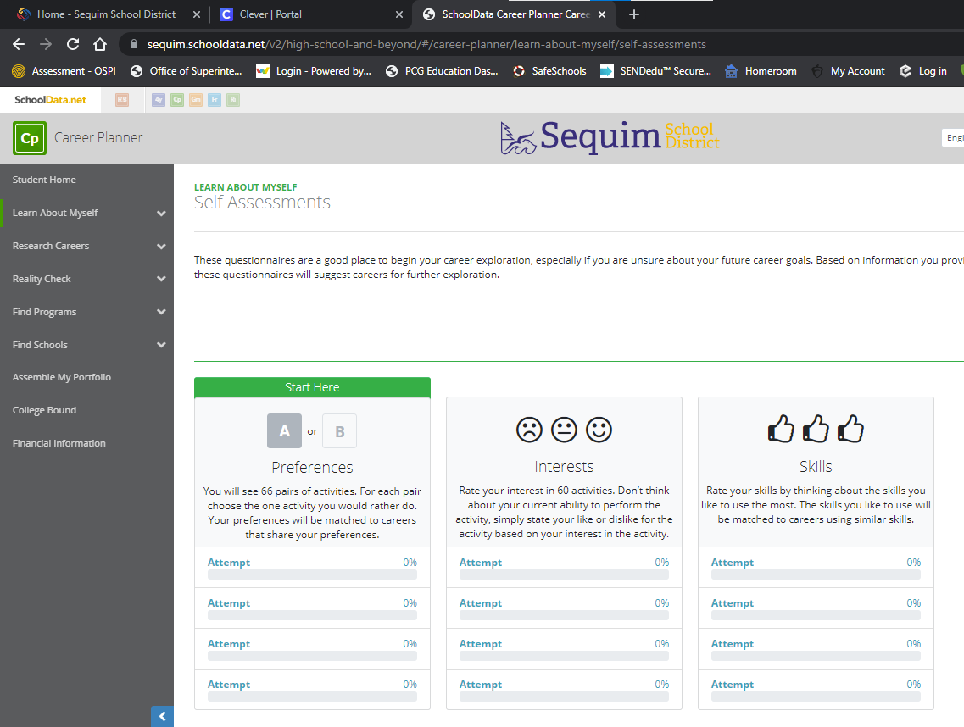
Preferences Self-Assessment
There are three self-assessments. To begin, click on the "Attempt" bar here:
You will be making quick selections .
Don't think too much, just quickly select which one is more immediately appealing.
When you have completed one survey, move onto the next.

Slide 17
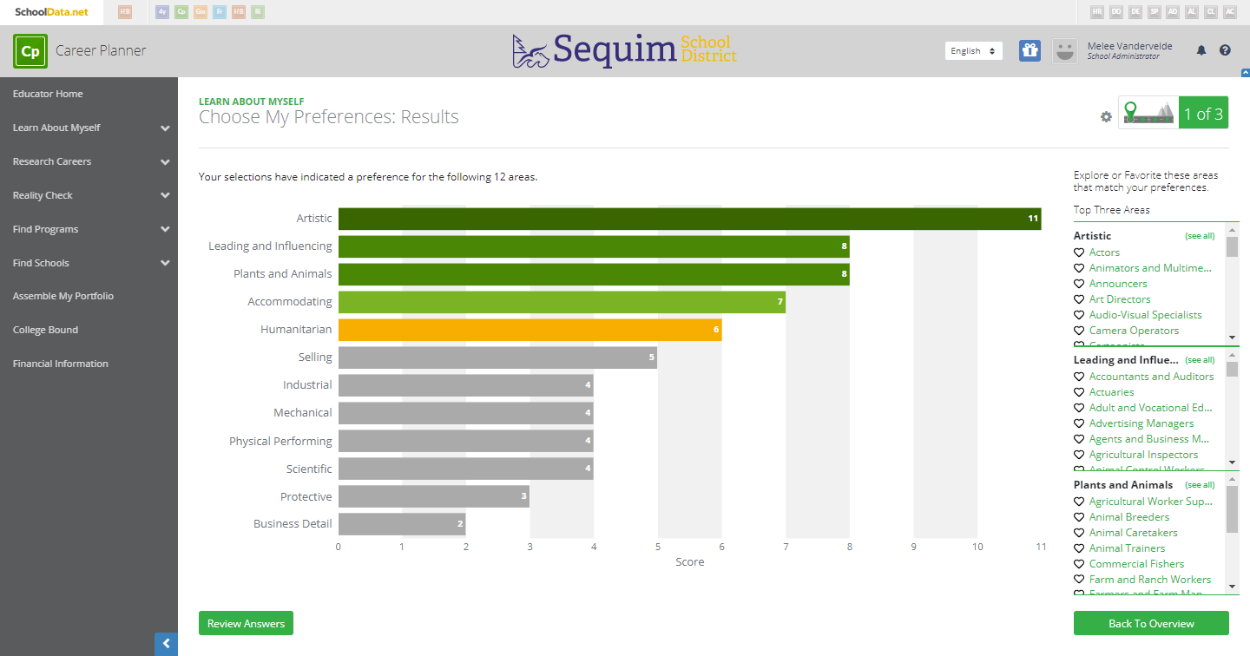
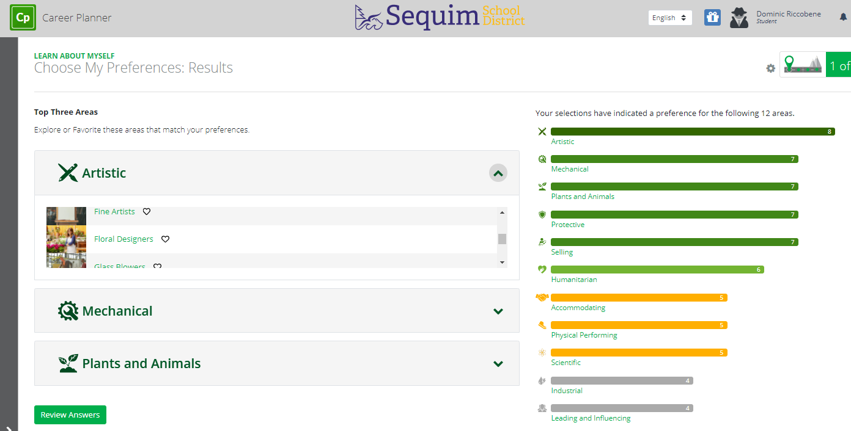
What are your results?
After completing each survey, you will receive results.
For the Preferences survey, you will see potential jobs that align with your preferences on the right or under the top three areas of interest for you
You can click on any of these jobs to learn more.
"Heart" at least 5 and no more than 15 jobs that interest you.

Slide 18
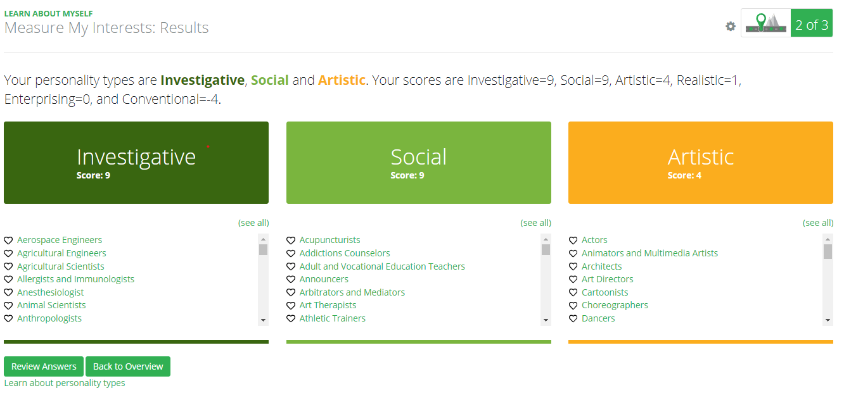
What are your results?
For the Interests survey you will see potential jobs that align with your interests
You can click on any of these jobs to learn more.
"Heart" at least 5 and no more than 15 jobs that interest you. We'll be using this information as we continue to develop your High School and Beyond Plan.

Slide 19
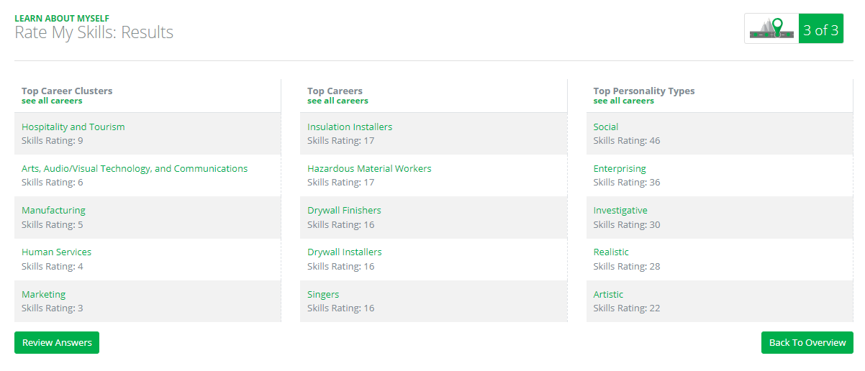
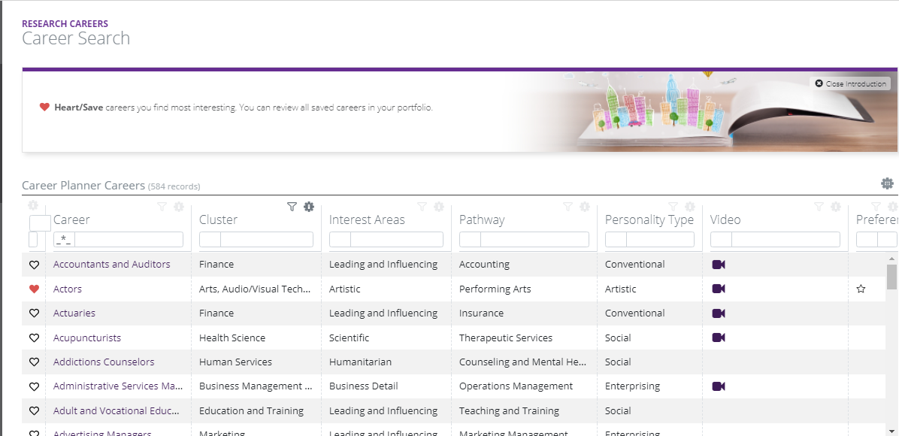
What are your results?
For the Skills survey you can click on 'See all Careers'
This is another way you can 'Favorite' various careers.
After completing all three surveys, please make sure you have selected 5-15 'Favorite' careers.
This creates your Career Cluster, which is part of the graduation requirement.

Slide 20
You are done with two components!
Next time we'll work on Career Goals and Educational Goals.

